Slide 1
Bell Schedule and Transportation Options for 2020-2021
Notes:
At the last meeting, we recommended placing two scenarios on the table in order to allow a time for public feedback. You agreed and on May 5th after your vote we placed the English version of the feedback form on our website. The Spanish language version was added the next day. Links to both the English and Spanish version were emailed to all parents in the school system on Wednesday May 6th.

Slide 2
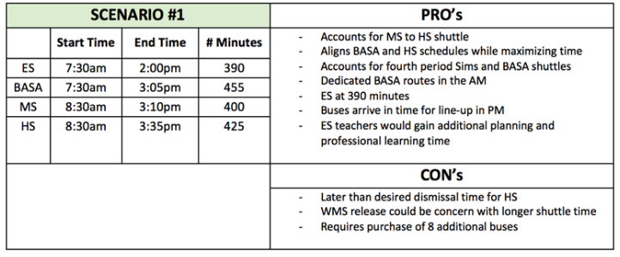
Bell Schedule/Transportation Options Feedback
Notes:
As of ??/??/???? We have had ?? Individual responses.

Slide 3
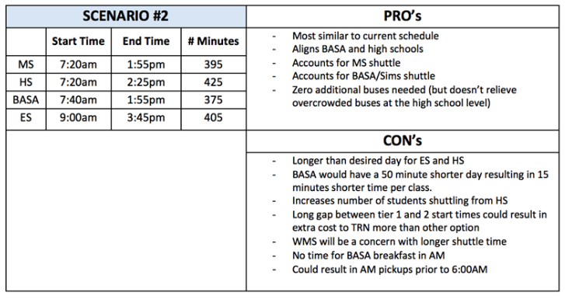
Bell Schedule/Transportation Options Feedback
Notes:
As of ??/??/???? We have had ?? Individual responses.

Slide 4
Bell Schedule/Transportation Options Feedback
4360
Individual Responses*
*As of May 21st at 6:25pm
Notes:
As of ??/??/???? We have had ?? Individual responses.

Slide 5
Affiliation by Role and Level
Group | Elementary | Middle | High | District | Total
Student | 190 | 207 | 382 | 21 | 800
Parent | 1765 | 1083 | 1191 | 94 | 4133
Teacher | 661 | 288 | 302 | 21 | 1272
Administrator | 20 | 13 | 6 | 9 | 48
Other BCSS | 168 | 113 | 132 | 69 | 482
Community | 253 | 154 | 191 | 88 | 686
Total | 3057 | 1858 | 2204 | 302 | 7421
Respondents could chose more than one role and level. For example, parent and teacher or parent of children at multiple levels. They only submitted one response but checked multiple levels and roles.

Slide 6
What do you like about Scenario 1?
Earlier start for ES and shorter day (16%)
Later start for MS/HS (15%)
Earlier end time for ES (11%)
“Nothing” - Do not like this scenario (9%)
Research -HS needs more rest/ ES better early in day (8%)
More planning time for ES (7%)
Transportation- less crowding on buses, ES doesn’t wait in PM (6%)

Slide 7
What do you dislike about Scenario 1?
“Nothing” – Like this scenario (17%)
Too early for younger students (14%)
Too late for MS/HS - due to sports, jobs, babysit (14%)
Childcare for students (9%)
Cost to transportation (7%)

Slide 8
What do you like about Scenario 2?
“Nothing” - Do not like this scenario (24%)
Early start/end for MS/HS (18%)
Later start/end for ES (13%)
Most like current schedule (13%)

Slide 9
What do you dislike about Scenario 2?
Too late start/end for ES (27%)
Too early for MS/HS (16%)
“Nothing” - Like everything about this scenario (11%)
Too long of a day again for ES (8%)
Not good for BASA – less time, late buses, no breakfast (7%)
Overcrowded buses (6%)
Dislike this scenario (6%)

Slide 10
What concerns you most about possible changes to the bell times and transportation options for 2020-2021?
Do not want early start for MS/HS and do not want late start for ES (12%)
Transportation Concerns – overcrowded buses, cost of new buses, long wait for ES pickups in afternoon (11%)
Would like assurance that ES students would have access to childcare before and after school (9%)
Do not want early start for ES and do not want late start for MS/HS (8%)
“Nothing” - Do not have any big concerns (6%)

Slide 11
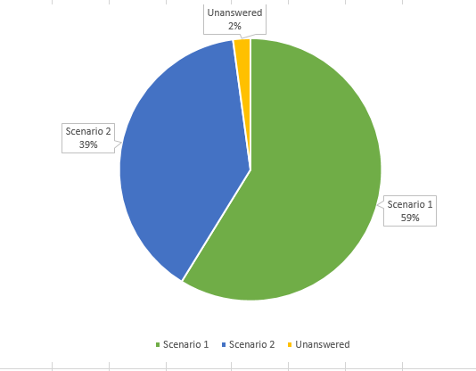
Which Scenario Do You Prefer?
Options | N =
Blanks | 93
Scenario 1 | 2563
Scenario 2 | 1704
 | 4360

Slide 12
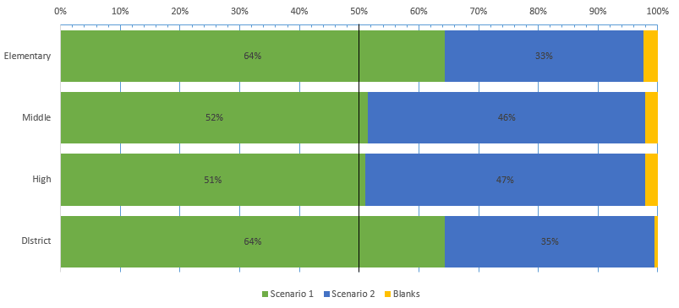
Preferred Scenario By Level
Responses | N =
Elementary | 2504
Middle | 1489
High | 1774
DIstrict | 202

Slide 13
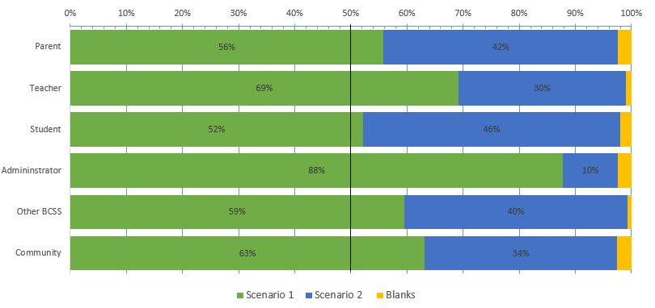
Preferred Scenario by Role
Responses | N =
Parent | 2741
Teacher | 1044
Student | 654
Admininstrator | 41
Other BCSS | 301
Community | 429

Slide 14
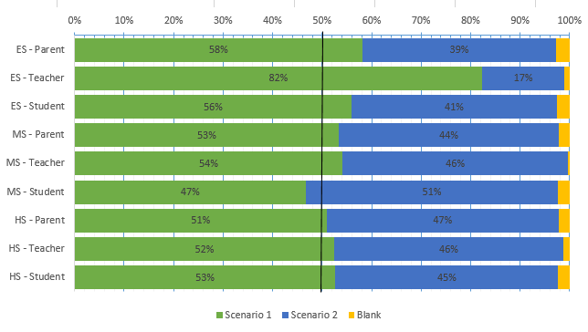
Preferred Scenario by Role and Level
Responses | N =
ES - Parent | 1791
ES - Teacher | 667
ES - Student | 193
MS - Parent | 1096
MS - Teacher | 290
MS - Student | 212
HS - Parent | 1212
HS - Teacher | 307
HS - Student | 389
Notes:
Be prepared to answer question about administrator preference by level.

Slide 15
Committee Recommendation:
The Three-Tier Study Committee recommends the Barrow County School System adopt Scenario 1 as presented.

