Slide 1
“Get the Scoop on Pre-K” Parent Orientation Bethlehem Elementary School
Presented by:
Mrs. Ducato
Mrs. Ellington
Ms. Mortensen
Notes:
‹#›

Slide 2
We Are Here To Help
Mrs. Ducato, Mrs. Ellington, and Mrs. Mortensen – Pre-K lead teachers
Mrs. Mull, Ms. Roberts, and Mrs. Johnson Pre-K assistant teachers
Ms. Tonya Royal- Barrow County Schools Pre-K Project Director
Ms. Mindy Reid Pre-K Site Director/School Principal
Mrs. Stephanie Martin, Assistant Principal
Email, call, or send us a note if you have questions or need assistance.
Notes:
‹#›

Slide 3
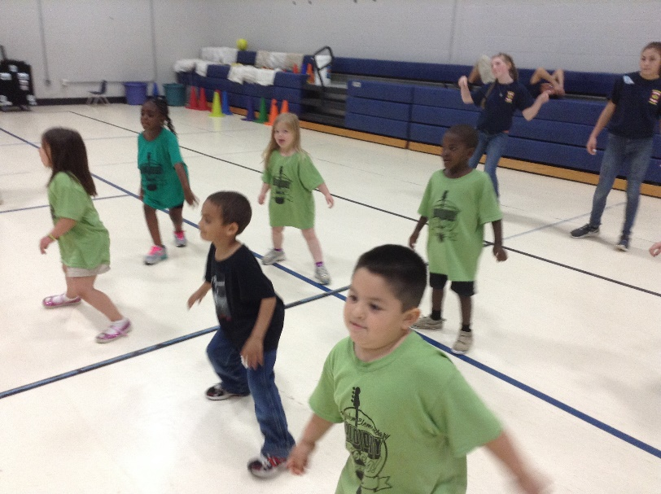
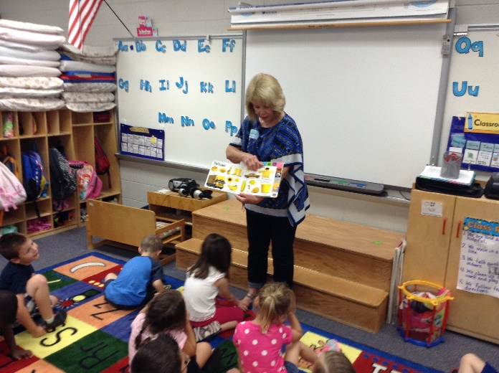
Daily Schedule Components
Opening Circle
Music and Movement
Story Times
Multiple Opportunities for Writing and Music
Great Time For Guest Readers
Notes:
Opening Circle- We open each day with the announcements, Pledge, moment of silence, and then instruction begins. We discuss both literary concepts such as alphabet and print concepts, as well as, math concepts during our calendar time. It is very important to avoid being tardy because of all the valuable instruction that begins with this part of the day. As the year progresses, the calendar time and opening circle becomes more advanced as well. We will also include a morning message as part of the calendar where children share in writing and see writing modeled.
‹#›

Slide 4
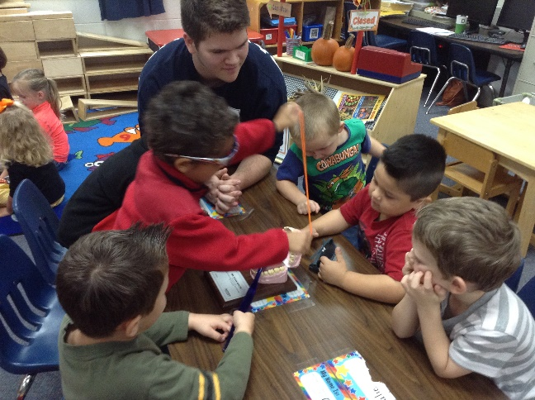
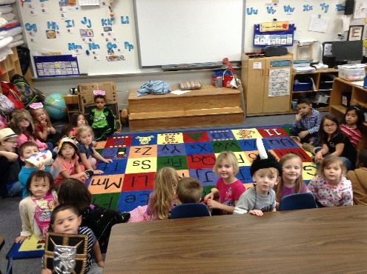
Daily Schedule Components
Small Group Work
Large Group Times
Another Great Time For Volunteers
We also teach and develop positive behaviors in large group.
Notes:
Our small groups are based on student needs, so many times the groups will be working/focusing on different concepts or levels of the same concept. The groups will probably change from week to week. At first—we have one teacher group and the other teacher trains and monitors independent groups. Later– we will have two teacher groups and two or three independent groups once the children have learned how to work and get assistance in independent groups.
We use our assessments to determine what the needs and instruction should be in small group. All activities have a purpose during this time.
This is a great time for volunteers. We would always love to have help to monitor groups during this time.
Large Group- These are times where we learn together. They often involve a story reading, but can integrate other areas of learning such as science, social studies, the arts, and math. We also learn about school rules and working together in large groups as well.
‹#›

Slide 5
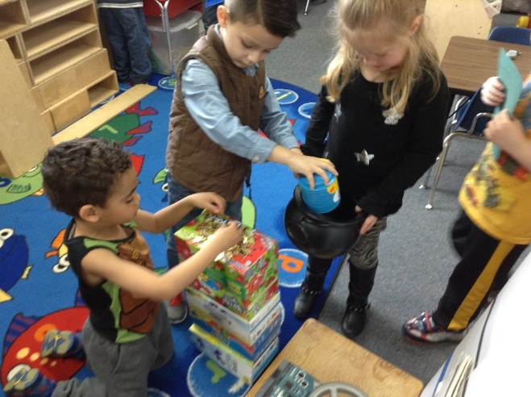
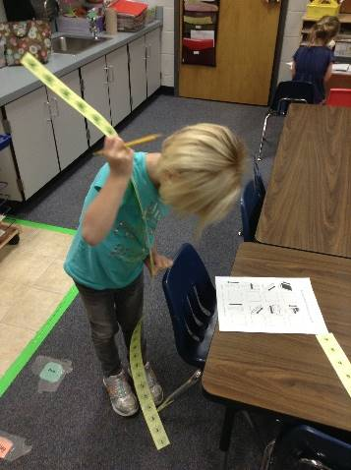
Daily Schedule Components
Phonological Awareness
Listening
Rhyming
Alliteration
Sentence Segmenting
Syllable Segmenting/blending
Center Time
Key to Reading Success
Mathematical Thinking
Increasing focus on the processes and communication in problem solving
includes number and quantity, measurement and comparison, mathematical reasoning, geometry and spatial understanding
Critical Thinking/Problem Solving and Hands-On
Notes:
Phonological Awareness is one of the most important skills to build for reading success. Research suggests that it is even more important than letter recognition. It should be taught prior to phonics instruction and can and should continue after phonics instruction begins. Phonological awareness is the ability to discriminate, hear, and manipulate the sounds in words. It is strictly an auditory skill, whereas phonics is matching print to sound.
We begin with listening skills and work through the levels of phonological awareness. Blending, onset-rime, and phoneme manipulation can be taught in Pre-K for those ready and should continue into the elementary years. Nursery rhymes, other rhymes, and rhyming songs are wonderful for teaching rhyme. Rhyming ability is the number one predictor of early and successful readers. Alliteration is recognizing when words begin the same way. Sentence segmenting is being able to clap or count the number of words in a sentence. Syllable segmenting is clapping or counting the number of word parts (syllables in words) or being able to listen to syllables that are seperated such as wa-ter-mel-on and hear that the words being said is watermelon. Onset and rime is knowing that c-at is the word cat. Phoneme manipulation is knowing that you can replace a /b/ with a /m/ in mat and get the word bat.
Center Time is an hour of uninterrupted student driven work and play.
This is where they are making choices, building language skills, problem solving skills, etc. We play with them and guide/expand their learning through our play with them. We are also taking notes, pictures, work samples, etc. to use in our portfolios which will later drive our instruction. This is not a quiet time and we would love for you to join us to help play with the children during this time.
We do not use worksheets or dittos. Everything is hands-on and game oriented or with the use of authentic materials. We also collect a lot of info and display the room, so it may be awhile before you see lots of work coming home. When we teach the children to sort, count, or pattern—they will be using real objects. This is more engaging than dittos. Although dittos have a place, they are not allowed to be a part of the Georgia Pre-Program. Each day we will focus on a different domain within mathematics (number/quantity understanding, patterning, sorting and classification, geometry and space, and measurement.)
‹#›

Slide 6
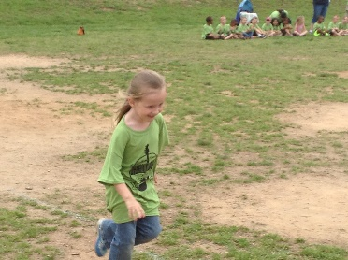
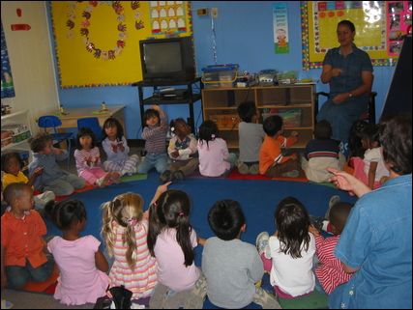
Daily Schedule Components
Other Daily Activities
Outdoor Activities*
Rest
Snack Time*
Lunch (café style)*
Closing Circle
Review of the day
Preview of the next day
*Considered Instructional Time
Summary
Notes:
During closing circle, we review our day or parts of our day and we will preview an upcoming event, activity, or center time material. This gives the children time to reflect on their learning and to become excited about new learning. If your child tells you that they did nothing at school or just played, be very specific with questions. Ask questions such as: What did you work on or play at center time? What did you hear about in storytime? What song did you dance to?
‹#›

Slide 7
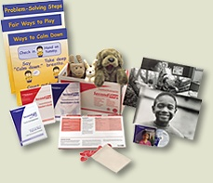
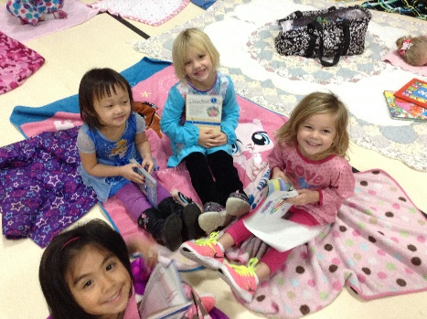
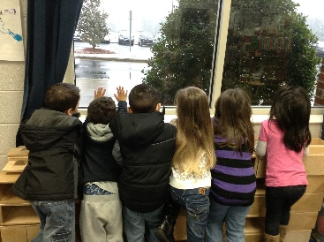
Classroom Management
Positive Reinforcement
include the whole class
promote teamwork
modeling/re-teaching what to say and do
Teach empathy, emotion management and problem solving
Logical/Natural Consequences
link the behavior to the consequence to reduce the unwanted behavior in the future
for young children, it may take several times for them to link the logical or natural consequence to their behaviors
Replacing Unwanted Behaviors with Wanted Ones
Teaching and Reteaching
Notes:
In our class, we earn rewards as a whole group. These rewards are stars from the class jar that we can empty for a When one doe class treat such as popscicles, popcorn, or a trip to prize box. We do not exclude anyone from these since we earn these together. We consider ourselves a class family, so like any family when one does well, we all do well and celebrate it.
As mentioned in the packet sent home at the beginning of the year, if your child needs a private behavior plan, we will do that individually and privately, but there will be no class lists of those that did/did not earn stickers or stars for the day.
Much of our classroom management is teaching and reteaching appropriate behaviors. We want to replace unwanted behaviors with wanted ones, so rather than punish—we teach behaviors like any other skill that needs to be learned.
When unwanted behaviors happen, there should be consequences as part of the teaching of new behaviors. We use logical and natural consequence whenever possible because they link the unwanted behavior to the unwanted consequence. Many times, time-outs and punishments do not link the behavior to the consequence– so learning doesn’t take place as quickly.
Logical consequences- Those are used when natural ones are too dangerous or when there really is no natural consequence. For example– if you run in the hall, you have to start again and walk. This means the class may arrive at the destination before you.
Natural consequences are a direct consequence of the behavior. They are used when it is safe to do so. It would not be safe to allow a child to continue running in the hall until he falls or bumps into something. An example of a natural consequence is the children throw the playground balls to high and they go over the fence. They can not play with the ball until the teacher is willing to go and get it because they are out of the acceptable play zone.
‹#›

Slide 8
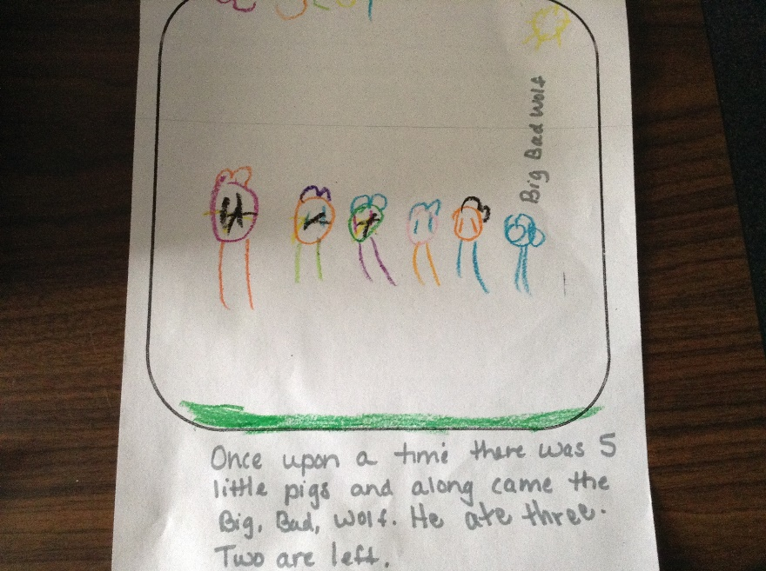
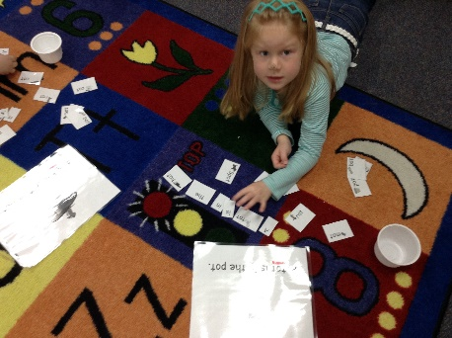
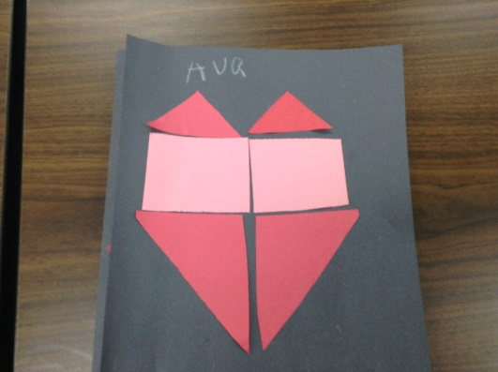
Georgia Pre-K Assessment
Assess in all domains of learning through online assessment.
Evidence of learning is through notes, work samples, photos.
Instruction is driven by assessments/GELDS.
A minimum of 2 conferences to review progress at the end of each semester.
The standards are the Georgia Early Learning and Development Standards (GELDS
www.gelds.decal.ga.gov
Notes:
We keep a portfolio assessment for each child in the seven domains of learning: Language and Literacy, Mathematical Thinking, Scientific Thinking, Social Studies, Personal and Social Development, Physical Development, and The Arts. Throughout the first and second semester of school, we will collect observational notes, work samples, and photos that demonstrate the progress of your child in each of these areas. That is one reason that not much work comes home. We collect it for the portfolios and share it with you at our two required conferences per year. We are also decorating the room in student-driven work. Once the year progresses and the portfolios become full and the walls are decorated, we can send more home.
All of our instruction is developed from the content standards we much teach, the assessment of the student portfolios, and student interest, so the portfolios drive the instruction and we use them when planning for what the children need. This is why children may have different tasks or be in different groups during small group time.
We typically do our Pre-K conferences on different schedule than elementary. We are required to hold portfolio/progress report conferences at the end of each semester (usually Dec. or Jan and during the last two weeks of school). Of course we are willing to conference with you at anytime, but we will not have a written progress report available until the end of Georgia Pre-K’s reporting period.
‹#›

Slide 9
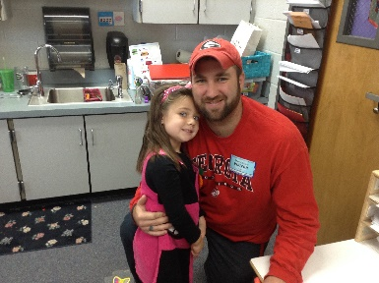
Family Involvement
Pre-K Newsletters
PreK events
volunteers for small group monitoring/help
guest readers
sharing special hobbies/talents
leading special craft times
helping room Mom
helping with school-wide events
family photos for display
THANKS FOR ALL YOUR HELP AND SNACKS!!!
Go to www.decal.ga.gov for family handbook and Pre-K newsletters.
Our school-wide goal is to have each parent donate one hour of time or talent to our school this year.
Notes:
The Family Handbook for Georgia Pre-K families and Georgia Pre-K newsletters are not being printed this year due to budget cuts. You can obtain them at www.decal.ga.gov under the Pre-K link. The children will be given a book by the Governor later in the year with activities that the children and families can do with it. Ready For School Kits will be sent home at the end of year as part of a transition activity.
We would love for each parent to donate at least one hour of time to our classroom this year. See the lists above for ways to help. We need family photos and you can send in family photos of special family activities for us to hang as well.
‹#›

Slide 10
Special Forms/Communication
Medical /Medicine Forms
Transportation Changes (use only written note with signature)
Change of Address/Residency
Use of Daily Folders and Agenda
email address: connie.ellington@barrow.k12.ga.us
katie.ducato@barrow.k12.ga.us
cherish.mortensen@barrow.k12.ga.us
Absenteeism/Written Excuses
Tardiness
Early Dismissals
Be sure we are aware of changes. Contact us directly.
If your child is sick, please allow them to stay at home. We understand absences are necessary in these cases.
Notes:
Medical forms- parent must bring medicine to clinic/office with directions on how to use the medicine. It can not be sent in the child’s bookbag.
Transportation changes must be in writing and signed by the parent. The school will not accept changes by email or phone. If you can fax a photo id and the written permission by 1:30pm– exceptions can be made. Also– be sure to tell us directly of any changes. Sometimes other parties may not relay the message in time.
Please inform us if your residence or phone numbers change in case we need to contact you for emergencies. Please keep immunizations up to date as well.
Georgia Pre-K does monitor absences and tardies. If you are absent, please send in a note as to why. If there are too many absences or tardies, the counselors may contact you to see how the school can help to cut down on them. For excessive, unexcused absences– a child can be dismissed from the program, so be sure to let us know if the child is out due to sickness. We do want them to stay home if they are sick. That is always ok and excused, but we are asking you to reserve absences for sickness only.
Early dismissals need to be kept to a minimum as well since there are instructional activities planned up until the time we are dismissed from school.
Use the daily folder for sending in notes, ice cream money, etc. We may not see it otherwise. We will use it as well.
Transportation changes- in writing with parent signature. Can not be done over the phone unless you are able to fax a written note/photo id.
Change of address/residency-
Daily folder- that’s where we check. Be sure to put important info. there
Absenteeism- reserve for illness, 10 consecutive day can be disenrolled (for nonexcused ) Please put in writing why the child was out.
Tardiness- after 7:45am (child is considered absent)
Early Dismissals- go to the office to request the child. They will call for them (even if you are in the class volunteering, meeting, etc.)
‹#›

