Slide 1
Interest Info Night

Slide 2
01
04
02
05
Table of Contents
03
06
Program Details
What’s Next
Eligibility
Timeline
Booster Club Info
Reminders

Slide 3
Program Details

Slide 4
Core Values
Student 1st
Team
Effort
Athlete status & team membership is a privilege.
Decisions you make not only impact you, but your team. Let’s get stronger daily.
Effort is your choice everyday. We can teach a sport, we can not teach effort.

Slide 5
Outlook
Coaches
Area
Upcoming
Head Coach
Cory Peppers
Assistant Coaches
Clint Deaton &
Carlos Tejada
New this year - Division 2
Area 7
May Tryouts
Jamboree Game
Summer Workouts

Slide 6
Outlook II
Varsity
Roster
Players
4th year as a Varsity Sport at WBHS
Projected
15-18 Players - Varsity Roster
&
12-15 Players -
JV Roster
(If available)
7 Seniors graduating
11 Players returning
1 being with the program all years

Slide 7
Constant Improvement
Program Goals
Program Building
Culture
Fun-da-
mentals
Off-
Season
Players
Encouraging, energetic, and proud. Next Play Up.
Do the little things right, to prepare for the big moments
Compete with other teams spring/summer leagues
Conditioning
JV
Camps
Signing
Game IQ
Have a JV roster to intro more to the sport and strengthen the program
Players assist with community youth camps to create flow of interest
Get our first player signed to play college ball
Dedication

Slide 8
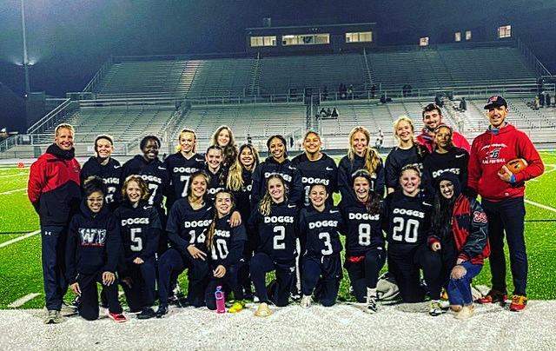
Growing Culture
Punched our ticket to the Playoffs! First in program history!
Area Award Recognitions

Slide 9
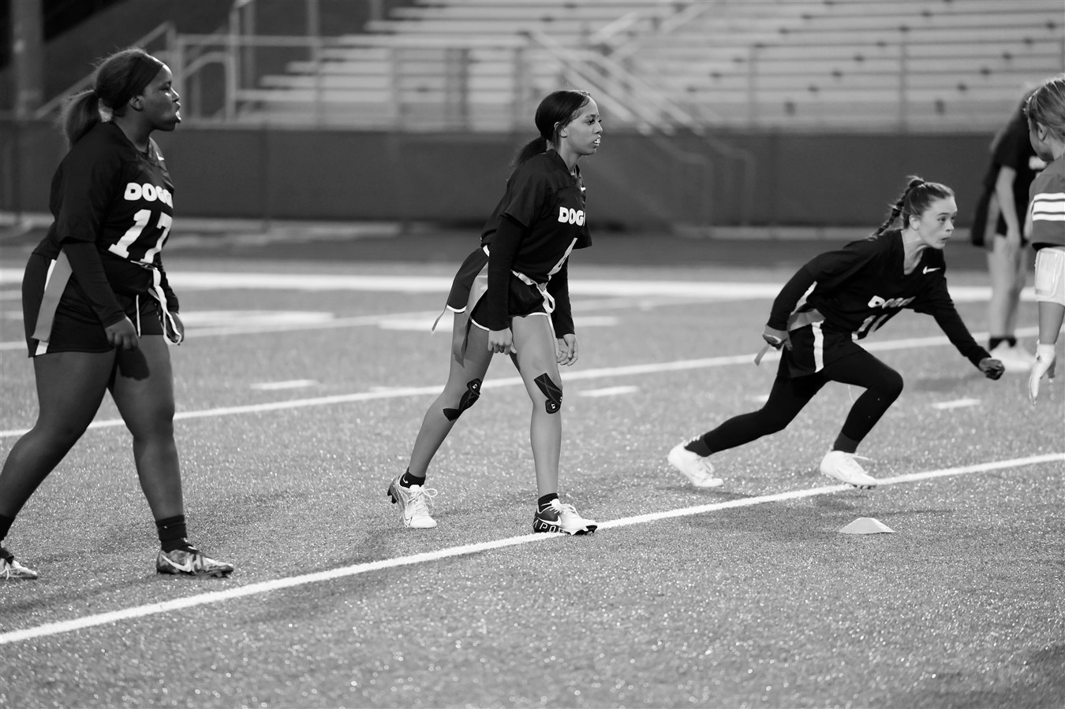
Eligibility

Slide 10
Eligibility
Must meet standards set by GHSA
Earned 2.5 credits in previous semester
Appropriate grade level
Team Rule - 70% In ALL Subjects
Poor grades impact playing time
Must have an updated physical on file
Must complete all steps by student and guardian on DragonFly
Must be insured
School insurance is available
&
Pass to Play
School Forms
Behavior reports from school will be handling according to the report given. Playing time can be impacted and dismissal from team may happen if infraction(s) are severe enough.

Slide 11
Booster Club

Slide 12
What is covered with the dues?
Dues
Player
TBD
Player Packs
Meals for away games
End of Season Banquet
Senior Banners
Senior Gifts
Manager
TBD
We do not receive any funds for these items from the school.

Slide 13
What are we raising money for?
Fundraising
Anything that is not covered by the dues.
More money raised the better the end of season banquet we can provide.
Looking to have a team fundraising event:
Car wash
Summer Camp for kids
When: We’ll discuss more at the player/guardian meeting in May

Slide 14
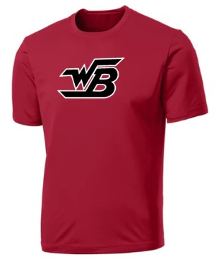
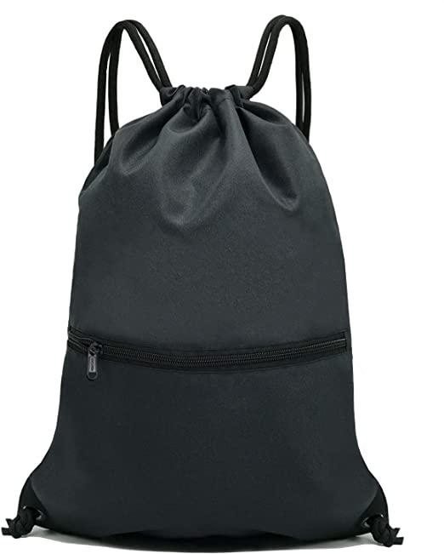
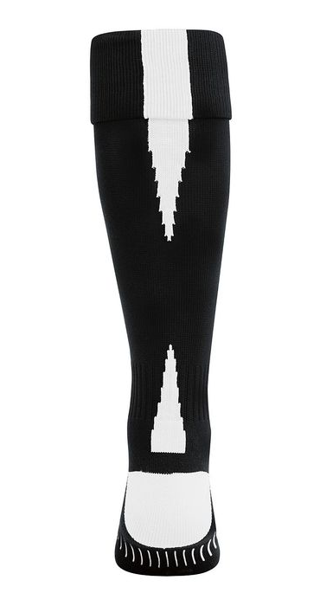
Prior PLayer Gear
*not final design
Parents/Family can order additional items with us
Hoodie
T-Shirt
Drawstring Bag
Socks
Hoodie
T-Shirt
Player Pack
Manager Pack

Slide 15
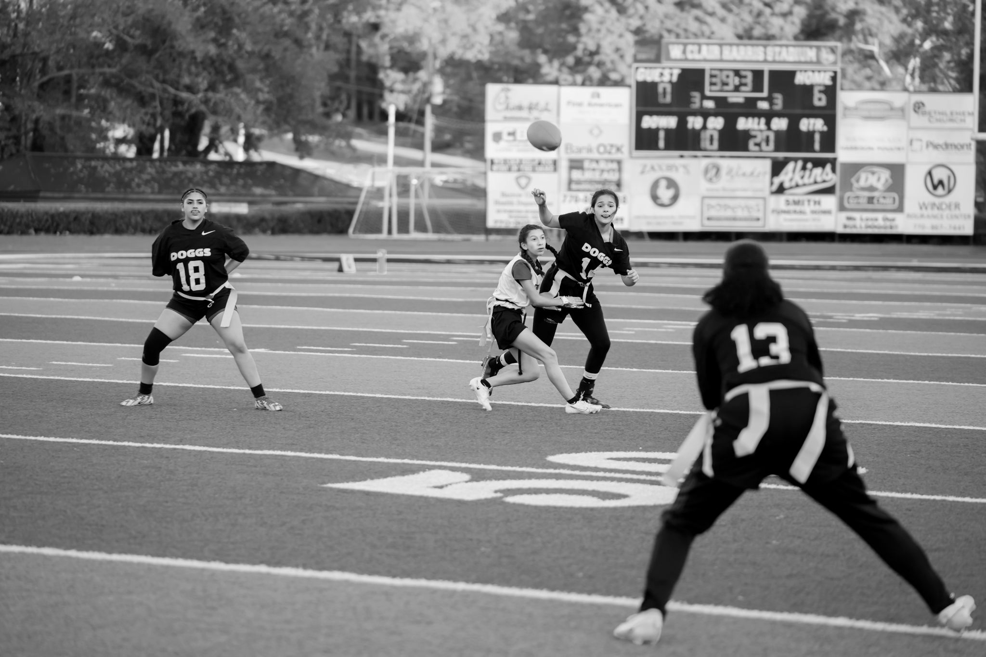
What’s Next

Slide 16
Physicals
New Potential Players
Must have a valid, current physical to tryout
Current Players
Make sure yours doesn’t expire before tryouts and during the season
Upload to DragonFly
WBHS’s official software for housing sports health documentation

Slide 17
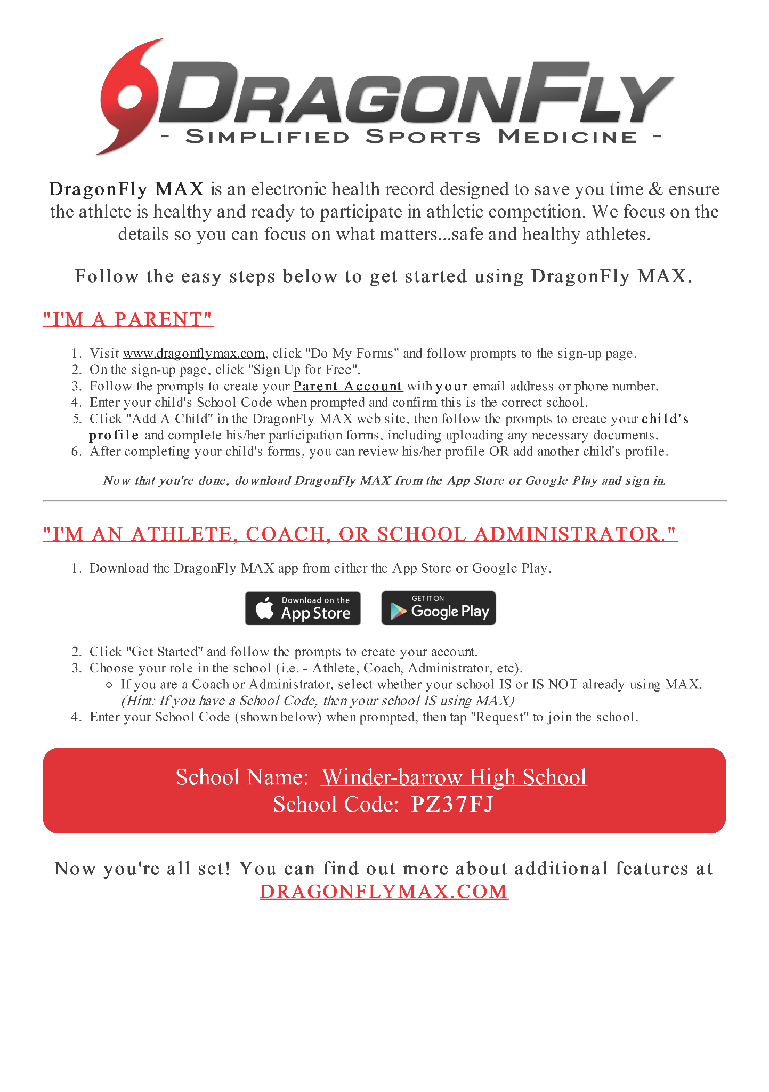
DragonFly
DragonFly
Houses the health records for student athletes
Player and Parent/Guardian
All forms MUST be completed before the first practice
Mobile App
Suggest downloading the mobile app

Slide 18
Managers
Water/Equipment
Sideline Assistance
Filling/emptying water and bringing equipment for practice and games
Assist coaches with play signs as needed
Film
Game Stats
Capturing quality video of game play
Compiling games statistics like: pulled flags, sacks, receptions, interceptions, etc.

Slide 19
Timeline

Slide 20
Upcoming Dates
Mar 10-15
March 29
May 18
Info Meetings with MS and HS
Flag Football Interest Info Night Parent/Guardian Meeting/Booster Club Info @ 6pm, WBHS Cafeteria
Jamboree Game
@ Dacula HS
5:30 vs Dacula
6:30 vs Monroe Area
Mar 20 - May 5
May 9-17
May 19
May 20
Tentative Tryout Schedule (5 days)
*Players must have valid Physical on file & DragonFly complete
Final Roster Posted via
Tentative Player Orientation and Booster Club Dues Meeting with Guardians
Projected schedule for 4 on 1s with out of season players

Slide 21
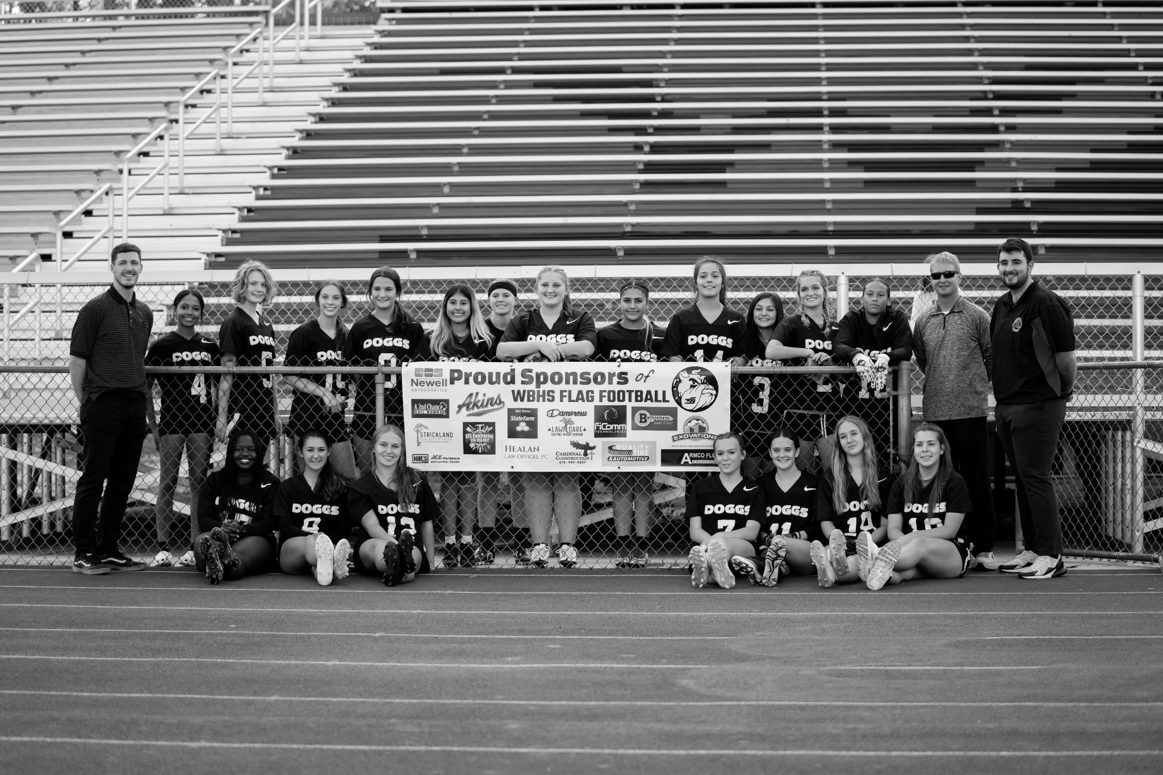
Reminders

Slide 22
Tryout Dates
Week 1
May 9
May 11
May 12
Turf field
4:15-5:45pm
*Must have valid Physical and DragonFly done
Turf field
4:15-5:45pm
Grass field
4:15-5:45pm
*Potential First Cuts posted via IG account
Week 2
May 15
May 17
May 18
May 19-20
Turf field
6:15-7:15pm
Turf field
6:15-7:15pm
Jamboree Game
@ Dacula HS
Leave by 4:30pm
5:30 vs Dacula
6:30 vs Monroe Area
May 19 - Final Roster posted via IG account
May 20 - Player Orientation

Slide 23
Gear Needs
Mouth Piece
Cleats
Most important item of equipment. Can not play without it.
Needed. Molded spikes. No metal tips allowed.
Head Bands
Gloves
Not necessary, but helpful.
Not necessary, but can assist. Suggest start without them and invest later if desired.
For tryouts, it would be great to have cleats, but if you want to wait until you’ve been selected for the team that is fine!

Slide 24
Don’t Forget
Reminders
Physicals Given at Winder-Barrow High School
Tickets need to be purchased from GOFAN
$15
Tentative Tryouts - May 9-17 from 4-6pm
Current In-Season Players - Must attend at least two days; not in-season
Official Player Orientation - May 20 - Saturday Morning Meeting
Official Player and Parent Info Session - May 20 - details to be announced
Booster Info, Orders, Fundraising
Summer Practices - June 2023

Slide 25
Thank You
Thank you for the interest in our program.
Any questions?
@wbhsflagfootball
https://www.barrow.k12.ga.us/schools/wbhs/athletics/flag-football

